Slide 2
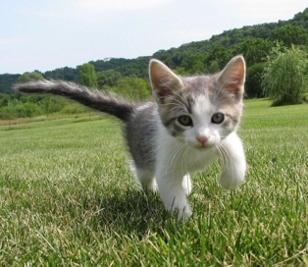
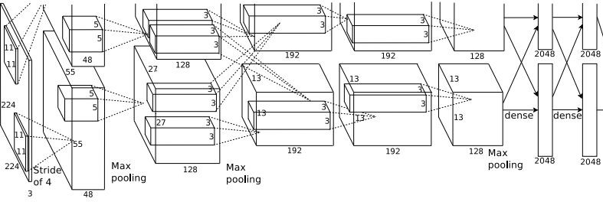
So far: Image Classification
Class Scores
Cat: 0.9
Dog: 0.05
Car: 0.01
...
Fully-Connected: 4096 to 1000
Vector:
4096
This image is CC0 public domain
2
May 14, 2019

Slide 3
Today: Segmentation, Detection

Slide 4


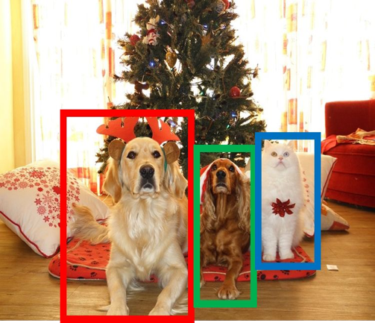
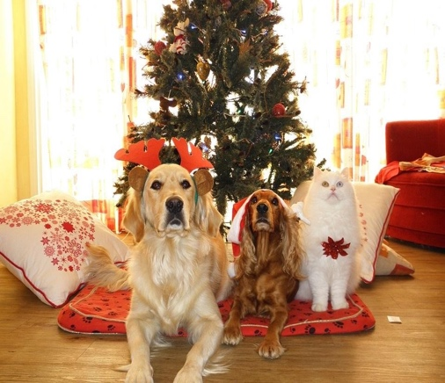
Computer Vision Tasks
Semantic Segmentation
Object Detection
Instance Segmentation
Classification
CAT
GRASS, CAT, TREE, SKY
DOG, DOG, CAT
DOG, DOG, CAT
No spatial extent
No objects, just pixels
Multiple Object
This image is CC0 public domain

Slide 5
Semantic Segmentation
Semantic Segmentation
_{Object} Instance
_{Detection} Segmentation
DOG, DOG, CAT DOG, DOG, CAT
Multiple Object
Classification
CAT
No spatial extent
GRASS, CAT, TREE, SKY
No objects, just pixels

Slide 6
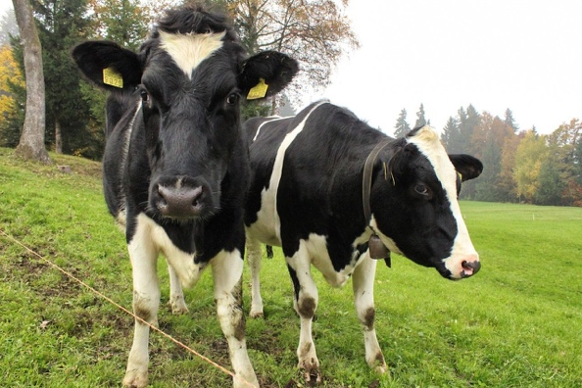
Semantic Segmentation
This image is CC0 public domain
Label each pixel in the image with a category label
Sky
Trees
Sky
Cow
Grass
Trees
Don’t differentiate instances, only care about pixels
Cat
Grass

Slide 7
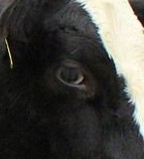
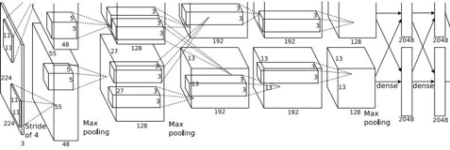

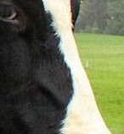

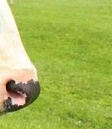

Semantic Segmentation Idea: Sliding Window
Classify center pixel with CNN
Extract patch
Full image
Cow
Cow
Grass
Farabet et al, “Learning Hierarchical Features for Scene Labeling,” TPAMI 2013
Pinheiro and Collobert, “Recurrent Convolutional Neural Networks for Scene Labeling”, ICML 2014

Slide 8
Semantic Segmentation Idea: Sliding Window
Classify center pixel with CNN
Extract patch
Full image
Cow
Cow
Grass
Problem: Very inefficient! Not reusing shared features between overlapping patches
Farabet et al, “Learning Hierarchical Features for Scene Labeling,” TPAMI 2013
Pinheiro and Collobert, “Recurrent Convolutional Neural Networks for Scene Labeling”, ICML 2014

Slide 9

Semantic Segmentation Idea: Fully Convolutional
Design a network as a bunch of convolutional layers to make predictions for pixels all at once!
Conv
Conv
Conv
Conv
argmax
Input:
3 x H x W
Predictions: H x W
Scores: C x H x W
Convolutions: D x H x W

Slide 10
Semantic Segmentation Idea: Fully Convolutional
Design a network as a bunch of convolutional layers to make predictions for pixels all at once!
Conv
Conv
Conv
Conv
argmax
Input:
3 x H x W
Predictions: H x W
Scores: C x H x W
Convolutions: D x H x W
Problem: convolutions at original image resolution will be very expensive ...

Slide 11
Semantic Segmentation Idea: Fully Convolutional
Design network as a bunch of convolutional layers, with
downsampling and upsampling inside the network!
Med-res: D₂ x H/4 x W/4
Med-res: D₂ x H/4 x W/4
Low-res: D₃ x H/4 x W/4
Input:
3 x H x W
High-res: D₁ x H/2 x W/2
High-res: D₁ x H/2 x W/2
Predictions: H x W
Long, Shelhamer, and Darrell, “Fully Convolutional Networks for Semantic Segmentation”, CVPR 2015
Noh et al, “Learning Deconvolution Network for Semantic Segmentation”, ICCV 2015

Slide 12
Semantic Segmentation Idea: Fully Convolutional
Downsampling: Pooling, strided convolution
Design network as a bunch of convolutional layers, with
downsampling and upsampling inside the network!
Upsampling:
???
Med-res: D₂ x H/4 x W/4
Med-res: D₂ x H/4 x W/4
Low-res: D₃ x H/4 x W/4
Input:
3 x H x W
High-res: D₁ x H/2 x W/2
High-res: D₁ x H/2 x W/2
Predictions: H x W
Long, Shelhamer, and Darrell, “Fully Convolutional Networks for Semantic Segmentation”, CVPR 2015
Noh et al, “Learning Deconvolution Network for Semantic Segmentation”, ICCV 2015

Slide 13
In-Network upsampling: “Unpooling”
Nearest Neighbor
1 | 1 | 2 | 2
1 | 1 | 2 | 2
3 | 3 | 4 | 4
3 | 3 | 4 | 4
“Bed of Nails”
1 | 0 | 2 | 0
0 | 0 | 0 | 0
3 | 0 | 4 | 0
0 | 0 | 0 | 0
1 | 2
3 | 4
1 | 2
3 | 4
Input: 2 x 2
Output: 4 x 4
Input: 2 x 2
Output: 4 x 4

Slide 14
In-Network upsampling: “Max Unpooling”
Max Pooling
Max Unpooling Use positions from pooling layer
Remember which element was max!
1 | 2 | 6 | 3
3 | 5 | 2 | 1
1 | 2 | 2 | 1
7 | 3 | 4 | 8
0 | 0 | 2 | 0
0 | 1 | 0 | 0
0 | 0 | 0 | 0
3 | 0 | 0 | 4
…
Rest of the network
1 | 2
3 | 4
5 | 6
7 | 8
Input: 4 x 4
Output: 2 x 2
Input: 2 x 2
Output: 4 x 4
Corresponding pairs of downsampling and upsampling layers
May 14, 2019

Slide 15
Learnable Upsampling: Transpose Convolution
Recall: Normal 3 x 3 convolution, stride 1 pad 1
Input: 4 x 4
Output: 4 x 4

Slide 16
Learnable Upsampling: Transpose Convolution
Recall: Normal 3 x 3 convolution, stride 1 pad 1
Dot product between filter and input
Input: 4 x 4
Output: 4 x 4

Slide 17
Learnable Upsampling: Transpose Convolution
Recall: Normal 3 x 3 convolution, stride 1 pad 1
Dot product between filter and input
Input: 4 x 4
Output: 4 x 4

Slide 18
Learnable Upsampling: Transpose Convolution
Recall: Normal 3 x 3 convolution, stride 2 pad 1
Input: 4 x 4
Output: 2 x 2

Slide 19
Learnable Upsampling: Transpose Convolution
Recall: Normal 3 x 3 convolution, stride 2 pad 1
Dot product between filter and input
Input: 4 x 4
Output: 2 x 2

Slide 20
Learnable Upsampling: Transpose Convolution
Recall: Normal 3 x 3 convolution, stride 2 pad 1
Filter moves 2 pixels in the input for every one pixel in the output
Dot product between filter and input
Stride gives ratio between movement in input and output
Input: 4 x 4
Output: 2 x 2

Slide 21
Learnable Upsampling: Transpose Convolution
3 x 3 transpose convolution, stride 2 pad 1
Input: 2 x 2
Output: 4 x 4

Slide 22
Learnable Upsampling: Transpose Convolution
3 x 3 transpose convolution, stride 2 pad 1
Input gives weight for filter
Input: 2 x 2
Output: 4 x 4

Slide 23
Learnable Upsampling: Transpose Convolution
3 x 3 transpose convolution, stride 2 pad 1
Filter moves 2 pixels in the output for every one pixel in the input
Input gives weight for filter
Stride gives ratio between movement in output and input
Input: 2 x 2
Output: 4 x 4
May 14, 2019

Slide 24
Learnable Upsampling: Transpose Convolution
3 x 3 transpose convolution, stride 2 pad 1
Sum where output overlaps
Filter moves 2 pixels in the output for every one pixel in the input
Input gives weight for filter
Stride gives ratio between movement in output and input
Input: 2 x 2
Output: 4 x 4
May 14, 2019

Slide 25
Learnable Upsampling: Transpose Convolution
3 x 3 transpose convolution, stride 2 pad 1
Sum where output overlaps
Other names:
-Deconvolution (bad)
-Upconvolution
-Fractionally strided convolution
-Backward strided convolution
Filter moves 2 pixels in the output for every one pixel in the input
Input gives weight for filter
Stride gives ratio between movement in output and input
Input: 2 x 2
Output: 4 x 4

Slide 26
Learnable Upsampling: 1D Example
Output
Input
Filter
 | ax
 | ay
 | az
 |  | + | bx
 |  |  | by
 |  |  | bz
Output contains copies of the filter weighted by the input, summing at where at overlaps in the output
x
a
y
b
Need to crop one pixel from output to make output exactly 2x input
z

Slide 27
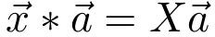
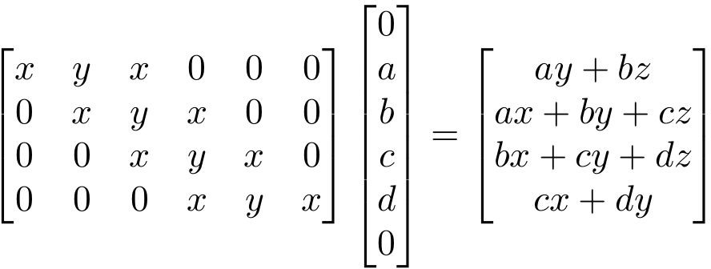
Convolution as Matrix Multiplication (1D Example)
We can express convolution in terms of a matrix multiplication
Example: 1D conv, kernel size=3, stride=1, padding=1

Slide 28
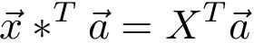
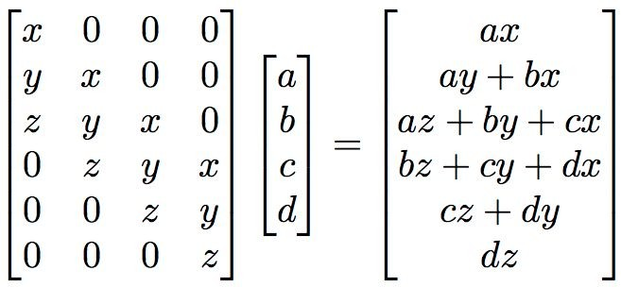
Convolution as Matrix Multiplication (1D Example)
We can express convolution in terms of a matrix multiplication
Convolution transpose multiplies by the transpose of the same matrix:
Example: 1D conv, kernel size=3, stride=1, padding=1
When stride=1, convolution transpose is just a regular convolution (with different padding rules)

Slide 29
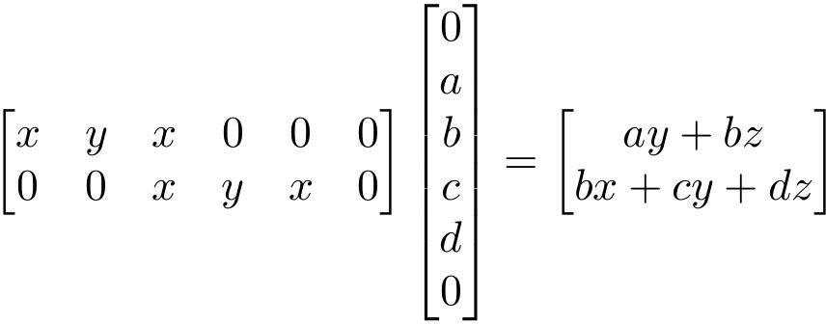
Convolution as Matrix Multiplication (1D Example)
We can express convolution in terms of a matrix multiplication
Example: 1D conv, kernel size=3, stride=2, padding=1

Slide 30
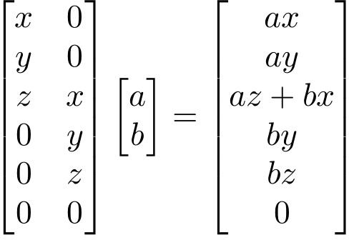
Convolution as Matrix Multiplication (1D Example)
We can express convolution in terms of a matrix multiplication
Convolution transpose multiplies by the transpose of the same matrix:
Example: 1D conv, kernel size=3, stride=2, padding=1
When stride>1, convolution transpose is no longer a normal convolution!
May 14, 2019

Slide 31
Semantic Segmentation Idea: Fully Convolutional
Design network as a bunch of convolutional layers, with
downsampling and upsampling inside the network!
Upsampling:
Downsampling: Pooling, strided convolution
Unpooling or strided transpose convolution
Med-res: D₂ x H/4 x W/4
Med-res: D₂ x H/4 x W/4
Low-res: D₃ x H/4 x W/4
Input:
3 x H x W
High-res: D₁ x H/2 x W/2
High-res: D₁ x H/2 x W/2
Predictions: H x W
Long, Shelhamer, and Darrell, “Fully Convolutional Networks for Semantic Segmentation”, CVPR 2015 Noh et al, “Learning Deconvolution Network for Semantic Segmentation”, ICCV 2015
May 14, 2019

Slide 32
Object Detection
Classification ^{Semantic} Segmentation
_{CAT} GRASS, CAT, TREE, SKY
No spatial extent No objects, just pixels
Object Detection
Instance
Segmentation
DOG, DOG, CAT
DOG, DOG, CAT
Multiple Object
May 14, 2019

Slide 33
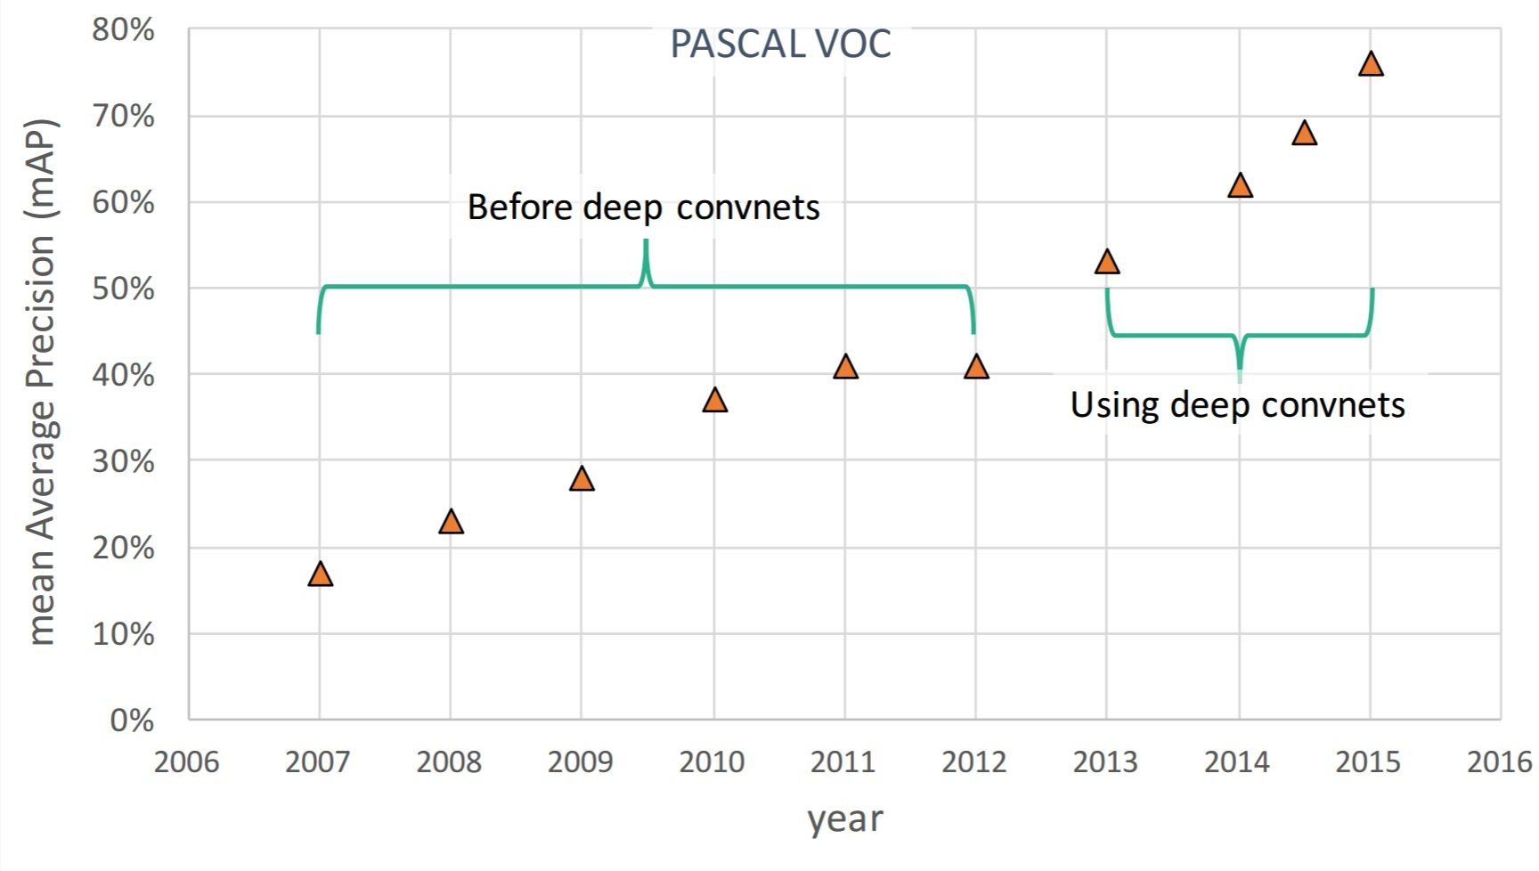
Object Detection: Impact of Deep Learning
Figure copyright Ross Girshick, 2015. Reproduced with permission.
May 14, 2019

Slide 34
Object Detection: Single Object
(Classification + Localization)
Class Scores
Cat: 0.9
Dog: 0.05
Car: 0.01
...
Fully Connected: 4096 to 1000
Vector:
4096
Fully Connected: 4096 to 4
This image is CC0 public domain
Box Coordinates (x, y, w, h)
Treat localization as a regression problem!
May 14, 2019

Slide 35
Object Detection: Single Object
(Classification + Localization)
Correct label:
Cat
Class Scores
Fully Connected: 4096 to 1000
Cat: 0.9
Dog: 0.05
Car: 0.01
...
Softmax Loss
Vector:
4096
Fully Connected: 4096 to 4
This image is CC0 public domain
Box Coordinates
L2 Loss
(x, y, w, h)
Treat localization as a
regression problem!
Correct box: (x’, y’, w’, h’)
May 14, 2019

Slide 36
Object Detection: Single Object
(Classification + Localization)
Correct label:
Cat
Class Scores
Fully Connected: 4096 to 1000
Cat: 0.9
Dog: 0.05
Car: 0.01
...
Softmax Loss
Multitask Loss
+
Loss
Vector:
4096
Fully Connected: 4096 to 4
This image is CC0 public domain
Box Coordinates
L2 Loss
(x, y, w, h)
Treat localization as a
regression problem!
Correct box: (x’, y’, w’, h’)
May 14, 2019

Slide 37
Object Detection: Single Object
(Classification + Localization)
Correct label:
Cat
Class Scores
Fully Connected: 4096 to 1000
Cat: 0.9
Dog: 0.05
Car: 0.01
...
Softmax Loss
+
Loss
Vector:
4096
Fully Connected: 4096 to 4
This image is CC0 public domain
Often pretrained on ImageNet (Transfer learning)
Box Coordinates
L2 Loss
(x, y, w, h)
Treat localization as a
regression problem!
Correct box: (x’, y’, w’, h’)
May 14, 2019

Slide 38


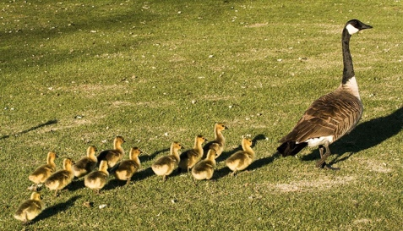
Object Detection: Multiple Objects
CAT: (x, y, w, h)
DOG: (x, y, w, h)
DOG: (x, y, w, h)
CAT: (x, y, w, h)
DUCK: (x, y, w, h)
DUCK: (x, y, w, h)
….
May 14, 2019

Slide 39

Object Detection: Multiple Objects
Apply a CNN to many different crops of the image, CNN classifies each crop as object or background
Dog? NO Cat? NO
Background? YES
May 14, 2019

Slide 40
Object Detection: Multiple Objects
Apply a CNN to many different crops of the image, CNN classifies each crop as object or background
Dog? YES
Cat? NO Background? NO
May 14, 2019

Slide 41
Object Detection: Multiple Objects
Apply a CNN to many different crops of the image, CNN classifies each crop as object or background
Dog? YES
Cat? NO Background? NO
May 14, 2019

Slide 42
Object Detection: Multiple Objects
Apply a CNN to many different crops of the image, CNN classifies each crop as object or background
Dog? NO Cat? YES
Background? NO
May 14, 2019

Slide 43
Object Detection: Multiple Objects
Apply a CNN to many different crops of the image, CNN classifies each crop as object or background
Dog? NO Cat? YES
Background? NO
Problem: Need to apply CNN to huge number of locations, scales, and aspect ratios, very computationally expensive!
May 14, 2019

Slide 44

Region Proposals: Selective Search
Find “blobby” image regions that are likely to contain objects
Relatively fast to run; e.g. Selective Search gives 2000 region proposals in a few seconds on CPU
Alexe et al, “Measuring the objectness of image windows”, TPAMI 2012 Uijlings et al, “Selective Search for Object Recognition”, IJCV 2013
Cheng et al, “BING: Binarized normed gradients for objectness estimation at 300fps”, CVPR 2014 Zitnick and Dollar, “Edge boxes: Locating object proposals from edges”, ECCV 2014
May 14, 2019

Slide 45
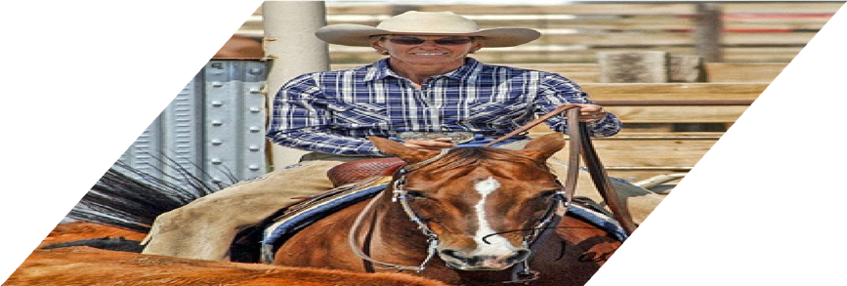
R-CNN
Girshick et al, “Rich feature hierarchies for accurate object detection and semantic segmentation”, CVPR 2014.
Figure copyright Ross Girshick, 2015; source. Reproduced with permission.
May 14, 2019

Slide 46

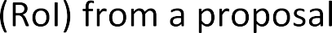

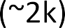
R-CNN
Girshick et al, “Rich feature hierarchies for accurate object detection and semantic segmentation”, CVPR 2014.
Figure copyright Ross Girshick, 2015; source. Reproduced with permission.
May 14, 2019

Slide 47
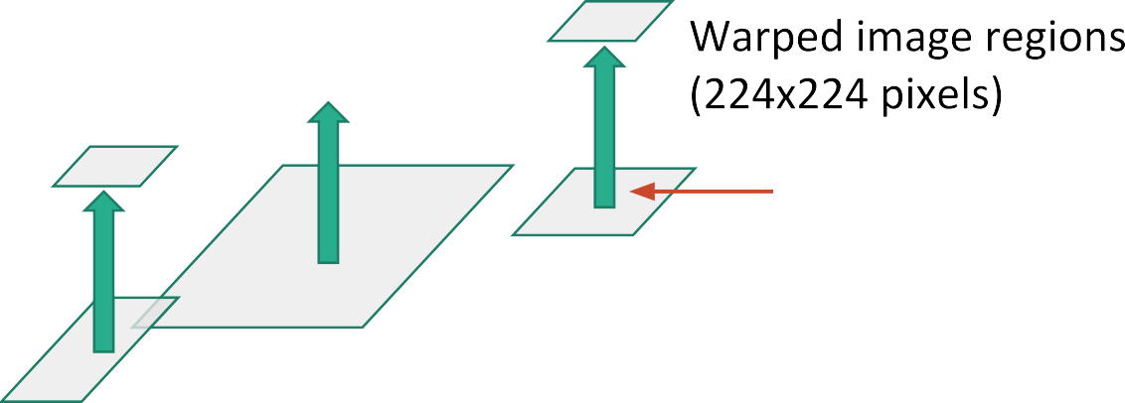
R-CNN
Girshick et al, “Rich feature hierarchies for accurate object detection and semantic segmentation”, CVPR 2014.
Figure copyright Ross Girshick, 2015; source. Reproduced with permission.
May 14, 2019

Slide 48
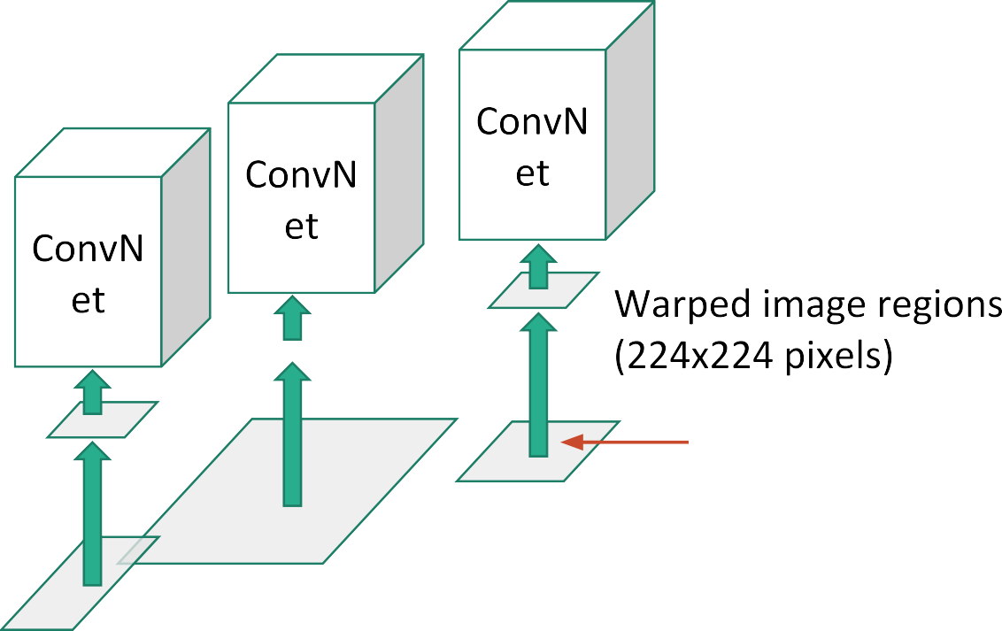


R-CNN
Girshick et al, “Rich feature hierarchies for accurate object detection and semantic segmentation”, CVPR 2014.
Figure copyright Ross Girshick, 2015; source. Reproduced with permission.
May 14, 2019

Slide 49
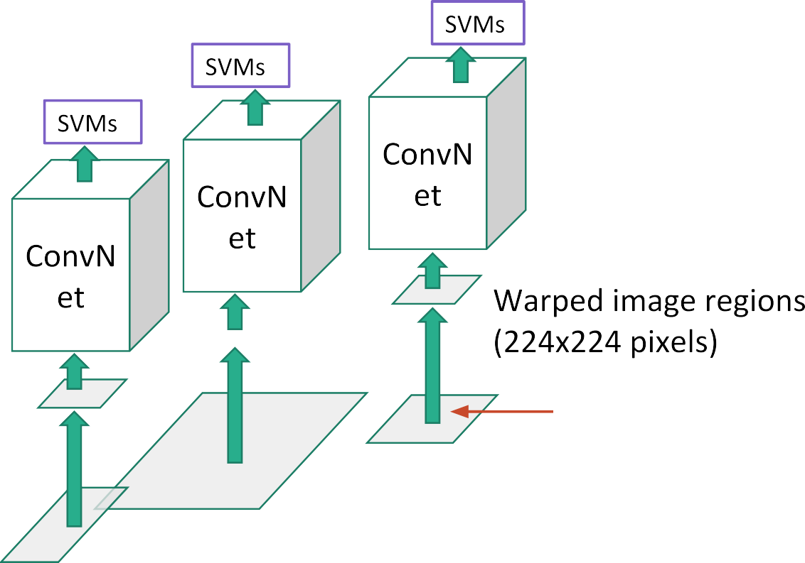

R-CNN
Girshick et al, “Rich feature hierarchies for accurate object detection and semantic segmentation”, CVPR 2014.
Figure copyright Ross Girshick, 2015; source. Reproduced with permission.
May 14, 2019

Slide 50
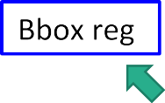
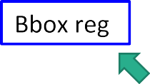
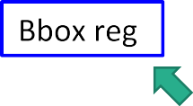
R-CNN
Girshick et al, “Rich feature hierarchies for accurate object detection and semantic segmentation”, CVPR 2014.
Figure copyright Ross Girshick, 2015; source. Reproduced with permission.
May 14, 2019

Slide 51
R-CNN
Problem: Very slow! Need to do ~2k independent forward passes for each image!
Girshick et al, “Rich feature hierarchies for accurate object detection and semantic segmentation”, CVPR 2014.
Figure copyright Ross Girshick, 2015; source. Reproduced with permission.
May 14, 2019

Slide 52


“Slow” R-CNN
Problem: Very slow! Need to do ~2k independent forward passes for each image!
Idea: Process image before cropping!
Swap convolution and cropping!
Girshick et al, “Rich feature hierarchies for accurate object detection and semantic segmentation”, CVPR 2014.
Figure copyright Ross Girshick, 2015; source. Reproduced with permission.
May 14, 2019

Slide 53
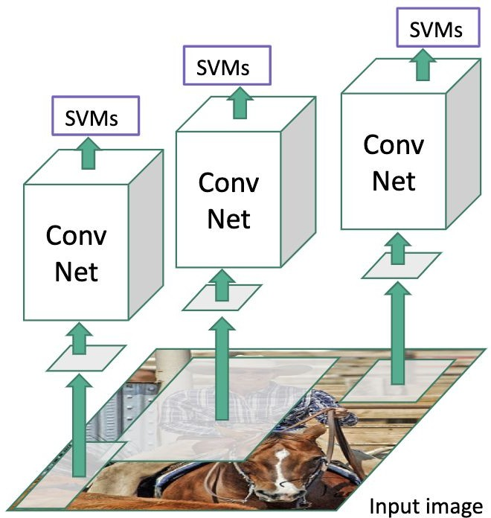
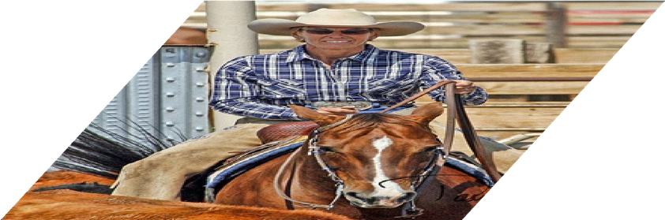

Fast R-CNN
“Slow” R-CNN
Girshick, “Fast R-CNN”, ICCV 2015. Figure copyright Ross Girshick, 2015; source. Reproduced with permission.
May 14, 2019

Slide 54



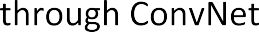




Fast R-CNN
“Slow” R-CNN
Girshick, “Fast R-CNN”, ICCV 2015. Figure copyright Ross Girshick, 2015; source. Reproduced with permission.
May 14, 2019

Slide 55



Fast R-CNN
“Slow” R-CNN
Girshick, “Fast R-CNN”, ICCV 2015. Figure copyright Ross Girshick, 2015; source. Reproduced with permission.
May 14, 2019

Slide 56
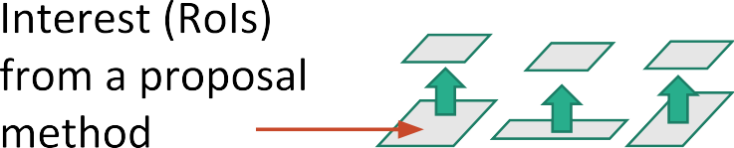
Fast R-CNN
“Slow” R-CNN
Girshick, “Fast R-CNN”, ICCV 2015. Figure copyright Ross Girshick, 2015; source. Reproduced with permission.
May 14, 2019

Slide 57
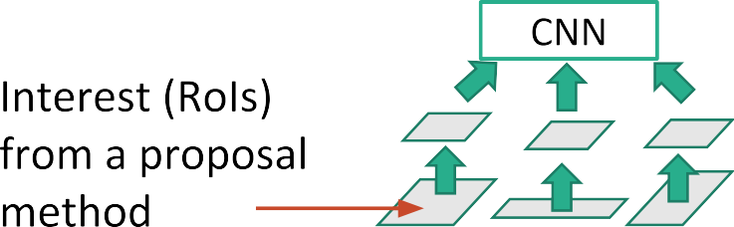

Fast R-CNN
“Slow” R-CNN
Girshick, “Fast R-CNN”, ICCV 2015. Figure copyright Ross Girshick, 2015; source. Reproduced with permission.
May 14, 2019

Slide 58
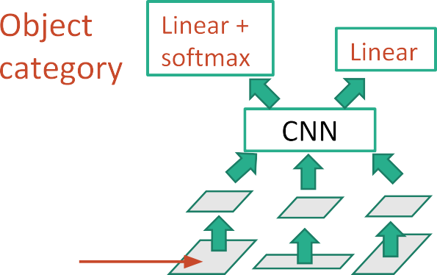


Fast R-CNN
“Slow” R-CNN
Girshick, “Fast R-CNN”, ICCV 2015. Figure copyright Ross Girshick, 2015; source. Reproduced with permission.
May 14, 2019

Slide 59
Fast R-CNN
“Slow” R-CNN
Girshick, “Fast R-CNN”, ICCV 2015. Figure copyright Ross Girshick, 2015; source. Reproduced with permission.
May 14, 2019

Slide 60
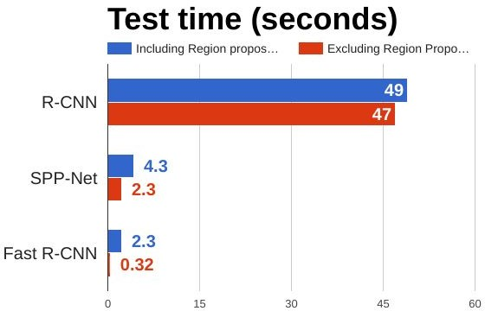
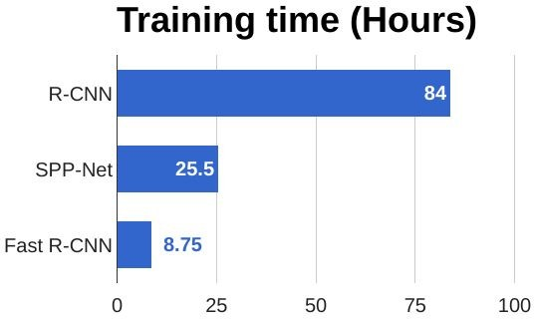
R-CNN vs Fast R-CNN
Girshick et al, “Rich feature hierarchies for accurate object detection and semantic segmentation”, CVPR 2014. He et al, “Spatial pyramid pooling in deep convolutional networks for visual recognition”, ECCV 2014
Girshick, “Fast R-CNN”, ICCV 2015
May 14, 2019

Slide 61
R-CNN vs Fast R-CNN
Problem:
Runtime dominated by region proposals!
Girshick et al, “Rich feature hierarchies for accurate object detection and semantic segmentation”, CVPR 2014. He et al, “Spatial pyramid pooling in deep convolutional networks for visual recognition”, ECCV 2014
Girshick, “Fast R-CNN”, ICCV 2015
May 14, 2019

Slide 62
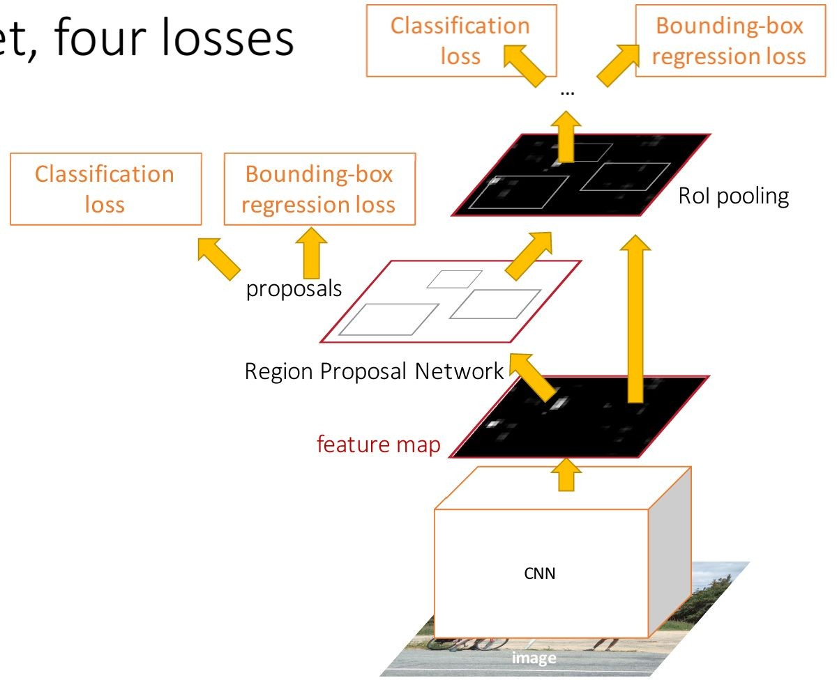
Faster R-CNN:
Make CNN do proposals!
Insert Region Proposal Network (RPN) to predict proposals from features
Otherwise same as Fast R-CNN: Crop features for each proposal, classify each one
Ren et al, “Faster R-CNN: Towards Real-Time Object Detection with Region Proposal Networks”, NIPS 2015 Figure copyright 2015, Ross Girshick; reproduced with permission
May 14, 2019

Slide 63

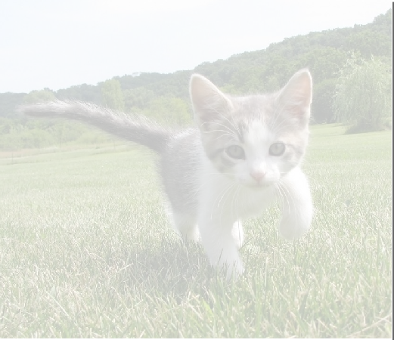
Region Proposal Network
CNN
Input Image (e.g. 3 x 640 x 480)
Image features (e.g. 512 x 20 x 15)
May 14, 2019

Slide 64
Region Proposal Network
Imagine an anchor box of fixed size at each point in the feature map
CNN
Input Image (e.g. 3 x 640 x 480)
Image features
(e.g. 512 x 20 x 15)
May 14, 2019

Slide 65
Region Proposal Network
Imagine an anchor box of fixed size at each point in the feature map
Anchor is an object?
1 x 20 x 15
CNN
Conv
At each point, predict whether the corresponding anchor contains an object (per-pixel logistic regression)
Input Image (e.g. 3 x 640 x 480)
Image features
(e.g. 512 x 20 x 15)
May 14, 2019

Slide 66
Region Proposal Network
Imagine an anchor box of fixed size at each point in the feature map
Anchor is an object?
1 x 20 x 15
CNN
Conv
Box transforms 4 x 20 x 15
For positive boxes, also predict a transformation from the anchor to the ground-truth box
Input Image (e.g. 3 x 640 x 480)
Image features
(e.g. 512 x 20 x 15)
(regress 4 numbers per pixel)
May 14, 2019

Slide 67
In practice use K different anchor boxes of different size / scale at each point
Region Proposal Network
Anchor is an object?
K x 20 x 15
CNN
Conv
Box transforms
4K x 20 x 15
Input Image (e.g. 3 x 640 x 480)
Image features (e.g. 512 x 20 x 15)
82
May 14, 2019

Slide 68
In practice use K different anchor boxes of different size / scale at each point
Region Proposal Network
Anchor is an object?
K x 20 x 15
CNN
Conv
Box transforms
4K x 20 x 15
Sort the K*20*15 boxes by their “object” score, take top
~300 as our proposals
Input Image (e.g. 3 x 640 x 480)
Image features (e.g. 512 x 20 x 15)
May 14, 2019

Slide 69
Faster R-CNN:
Make CNN do proposals!
Jointly train with 4 losses:
RPN classify object / not object
RPN regress box coordinates
Final classification score (object classes)
Final box coordinates
Ren et al, “Faster R-CNN: Towards Real-Time Object Detection with Region Proposal Networks”, NIPS 2015 Figure copyright 2015, Ross Girshick; reproduced with permission
May 14, 2019

Slide 70
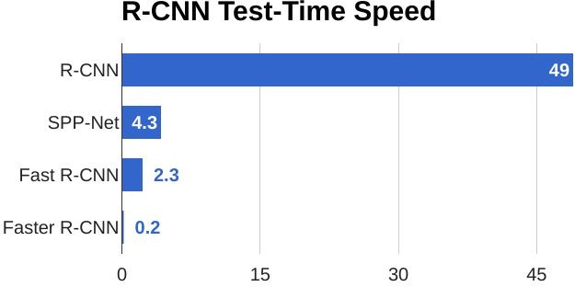
Faster R-CNN:
Make CNN do proposals!
May 14, 2019

Slide 71
Faster R-CNN:
Make CNN do proposals!
Glossing over many details:
Ignore overlapping proposals with
non-max suppression
How to determine whether a proposal is positive or negative?
How many positives / negatives to send to second stage?
How to parameterize bounding box regression?
Ren et al, “Faster R-CNN: Towards Real-Time Object Detection with Region Proposal Networks”, NIPS 2015 Figure copyright 2015, Ross Girshick; reproduced with permission
May 14, 2019

Slide 72
Faster R-CNN:
Make CNN do proposals!
Faster R-CNN is a
Two-stage object detector
First stage: Run once per image
Backbone network
Region proposal network
Second stage: Run once per region
Crop features: RoI pool / align
Predict object class
Prediction bbox offset
May 14, 2019

Slide 73
Faster R-CNN:
Make CNN do proposals!
Do we really need the second stage?
Faster R-CNN is a
Two-stage object detector
First stage: Run once per image
Backbone network
Region proposal network
Second stage: Run once per region
Crop features: RoI pool / align
Predict object class
Prediction bbox offset
May 14, 2019

Slide 74


Single-Stage Object Detectors: YOLO / SSD / RetinaNet
Within each grid cell:
Regress from each of the B base boxes to a final box with 5 numbers:
(dx, dy, dh, dw, confidence)
Predict scores for each of C classes (including background as a class)
Looks a lot like RPN, but category-specific!
Input image 3 x H x W
Divide image into grid 7 x 7
Image a set of base boxes centered at each grid cell Here B = 3
Output:
7 x 7 x (5 * B + C)
Redmon et al, “You Only Look Once:
Unified, Real-Time Object Detection”, CVPR 2016
Liu et al, “SSD: Single-Shot MultiBox Detector”, ECCV 2016 Lin et al, “Focal Loss for Dense Object Detection”, ICCV 2017
May 14, 2019

Slide 75
Object Detection: Lots of variables ...
Backbone Network VGG16
ResNet-101 Inception V2 Inception V3 Inception ResNet MobileNet
“Meta-Architecture”
Two-stage: Faster R-CNN Single-stage: YOLO / SSD Hybrid: R-FCN
Takeaways
Faster R-CNN is slower but more accurate
SSD is much faster but not as accurate
Image Size
# Region Proposals
…
Bigger / Deeper backbones work better
Huang et al, “Speed/accuracy trade-offs for modern convolutional object detectors”, CVPR 2017
R-FCN: Dai et al, “R-FCN: Object Detection via Region-based Fully Convolutional Networks”, NIPS 2016
Inception-V2: Ioffe and Szegedy, “Batch Normalization: Accelerating Deep Network Training by Reducing Internal Covariate Shift”, ICML 2015 Inception V3: Szegedy et al, “Rethinking the Inception Architecture for Computer Vision”, arXiv 2016
Inception ResNet: Szegedy et al, “Inception-V4, Inception-ResNet and the Impact of Residual Connections on Learning”, arXiv 2016 MobileNet: Howard et al, “Efficient Convolutional Neural Networks for Mobile Vision Applications”, arXiv 2017
May 14, 2019

Slide 76
Object Detection: Lots of variables ...
Backbone Network VGG16
ResNet-101 Inception V2 Inception V3 Inception ResNet MobileNet
“Meta-Architecture”
Two-stage: Faster R-CNN Single-stage: YOLO / SSD Hybrid: R-FCN
Takeaways
Faster R-CNN is slower but more accurate
SSD is much faster but not as accurate
Image Size
# Region Proposals
…
Bigger / Deeper backbones work better
Huang et al, “Speed/accuracy trade-offs for modern convolutional object detectors”, CVPR 2017 Zou et al, “Object Detection in 20 Years: A Survey”, arXiv 2019 (today!)
R-FCN: Dai et al, “R-FCN: Object Detection via Region-based Fully Convolutional Networks”, NIPS 2016
Inception-V2: Ioffe and Szegedy, “Batch Normalization: Accelerating Deep Network Training by Reducing Internal Covariate Shift”, ICML 2015 Inception V3: Szegedy et al, “Rethinking the Inception Architecture for Computer Vision”, arXiv 2016
Inception ResNet: Szegedy et al, “Inception-V4, Inception-ResNet and the Impact of Residual Connections on Learning”, arXiv 2016 MobileNet: Howard et al, “Efficient Convolutional Neural Networks for Mobile Vision Applications”, arXiv 2017
May 14, 2019

Slide 77
Instance Segmentation
Classification ^{Semantic} Segmentation
_{CAT} GRASS, CAT, TREE, SKY
No spatial extent No objects, just pixels
Instance Segmentation
Object
Detection
DOG, DOG, CAT
DOG, DOG, CAT
Multiple Object
May 14, 2019

Slide 78
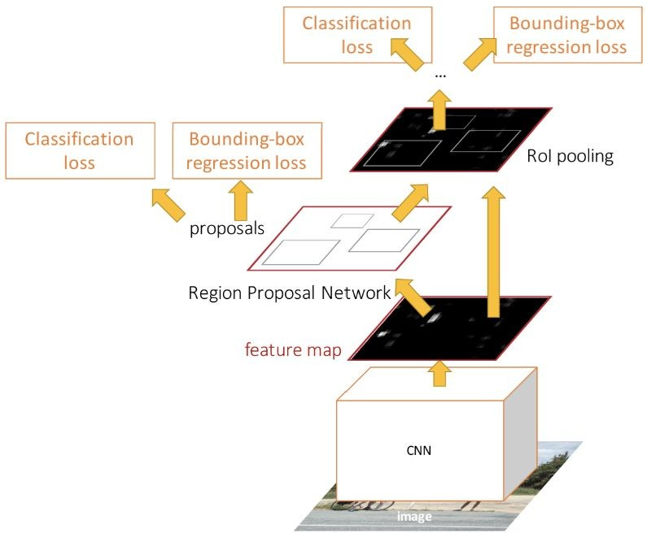
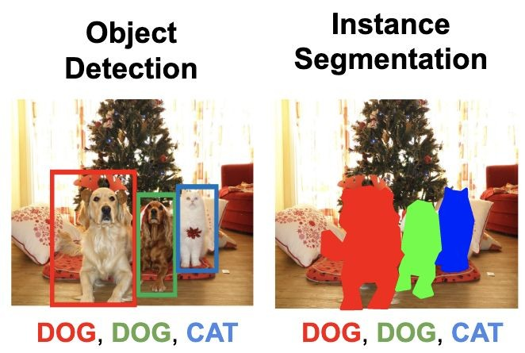
Object Detection: Faster R-CNN
May 14, 2019

Slide 79
Instance Segmentation: Mask R-CNN
Mask Prediction
Add a small mask network that operates on each RoI and predicts a 28x28 binary mask
He et al, “Mask R-CNN”, ICCV 2017
May 14, 2019

Slide 80
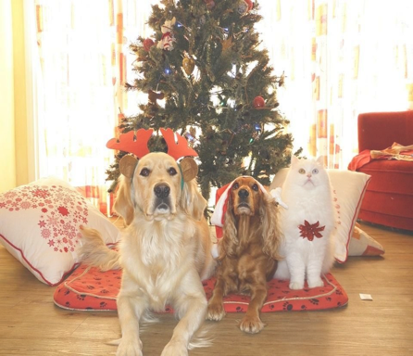
Mask R-CNN
Classification Scores: C
Box coordinates (per class): 4 * C
CNN
+RPN
Conv
Conv
RoI Align
256 x 14 x 14
256 x 14 x 14
Predict a mask for each of C classes
C x 28 x 28
He et al, “Mask R-CNN”, arXiv 2017
May 14, 2019

Slide 81
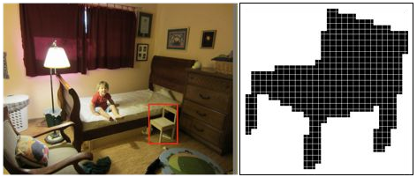
Mask R-CNN: Example Mask Training Targets
May 14, 2019

Slide 82
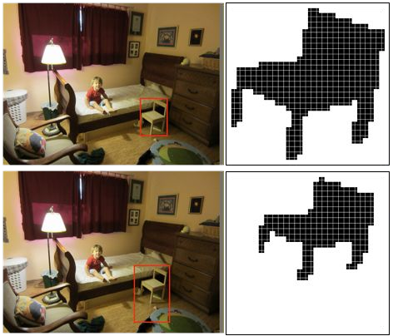
Mask R-CNN: Example Mask Training Targets
May 14, 2019

Slide 83
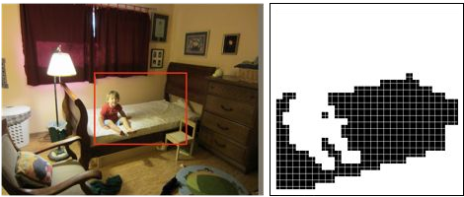
Mask R-CNN: Example Mask Training Targets
May 14, 2019

Slide 84
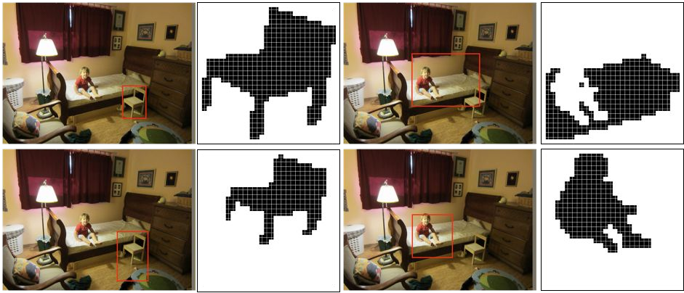
Mask R-CNN: Example Mask Training Targets
May 14, 2019

Slide 85
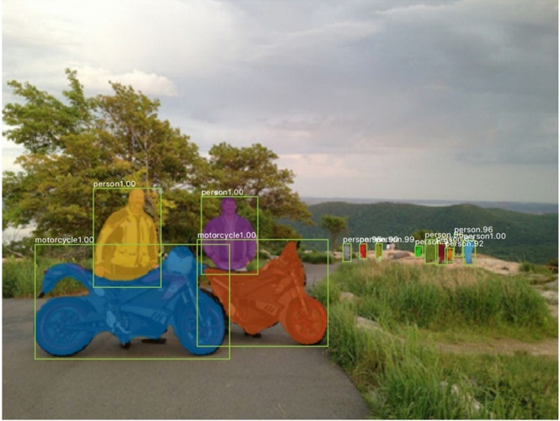
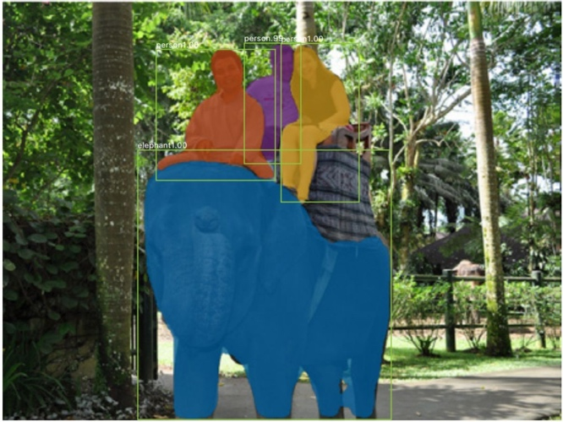
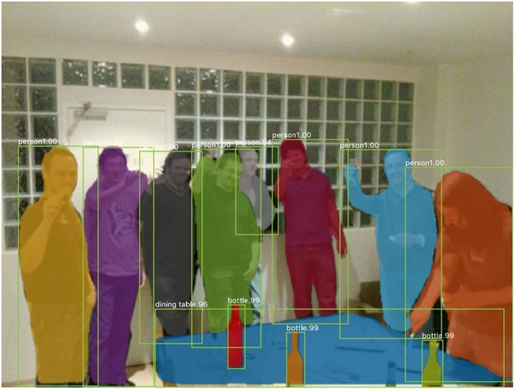
Mask R-CNN: Very Good Results!
He et al, “Mask R-CNN”, ICCV 2017
85
May 14, 2019

Slide 86
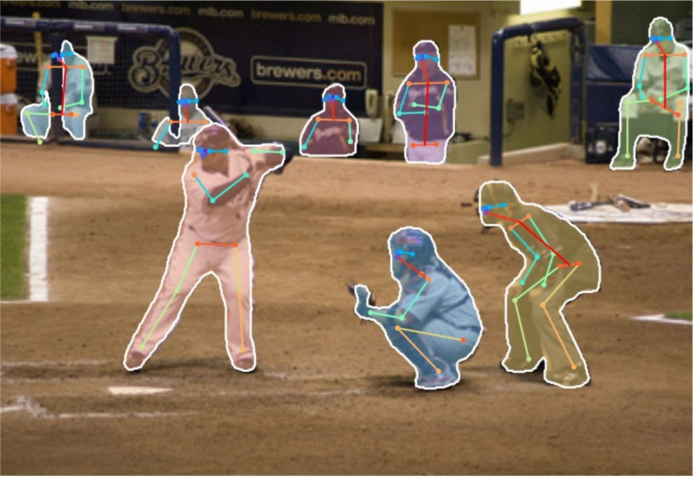
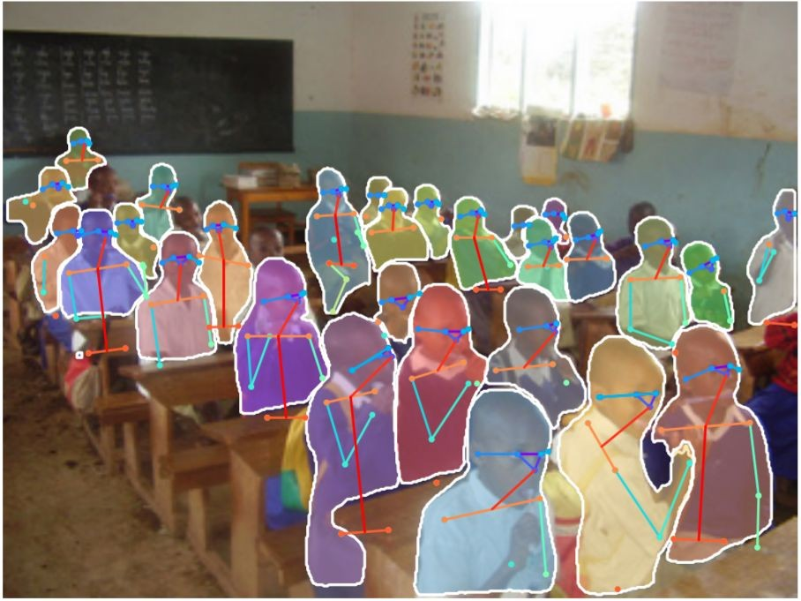
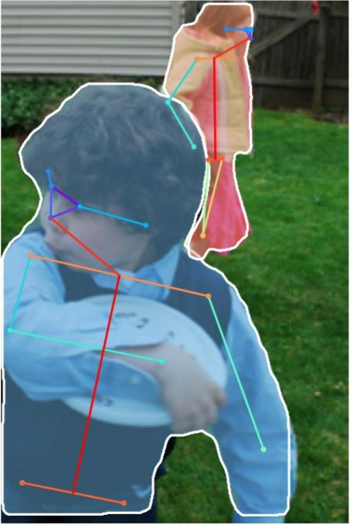
Mask R-CNN Also does pose
He et al, “Mask R-CNN”, ICCV 2017
86
May 14, 2019

Slide 87
Open Source Frameworks
Lots of good implementations on GitHub!
TensorFlow Detection API:
https://github.com/tensorflow/models/tree/master/research/object_detection Faster RCNN, SSD, RFCN, Mask R-CNN
Caffe2 Detectron:
https://github.com/facebookresearch/Detectron
Mask R-CNN, RetinaNet, Faster R-CNN, RPN, Fast R-CNN, R-FCN
Finetune on your own dataset with pre-trained models
87
May 14, 2019

Slide 88
Computer Vision Tasks
Semantic Segmentation
Object Detection
Instance Segmentation
Classification
CAT
GRASS, CAT, TREE, SKY
DOG, DOG, CAT
DOG, DOG, CAT
No spatial extent
No objects, just pixels
Multiple Object
This image is CC0 public domain
88
May 14, 2019

Slide 89
Beyond 2D Object Detection...
89
May 14, 2019

Slide 90

90
May 14, 2019

Slide 91



Objects + Relationships = Scene Graphs
Krishna, Ranjay, Yuke Zhu, Oliver Groth, Justin Johnson, Kenji Hata, Joshua Kravitz, Stephanie Chen et al. "Visual genome: Connecting language and vision using crowdsourced dense image annotations." International Journal of Computer Vision 123, no. 1 (2017): 32-73.
91
May 14, 2019

Slide 92

Scene Graph Prediction
Xu, Zhu, Choy, and Fei-Fei, “Scene Graph Generation by Iterative Message Passing”, CVPR 2017 Figure copyright IEEE, 2018. Reproduced for educational purposes.
92
May 14, 2019

Slide 93







3D Object Detection
This image is CC0 public domain
93
May 14, 2019

Slide 94





3D Object Detection: Simple Camera Model
3D ray
2D point
camera viewing frustrum
image plane
camera
Image source: https://www.pcmag.com/encyclopedia_images/_FRUSTUM.GIF
94
May 14, 2019

Slide 95


3D Object Detection: Monocular Camera
Faster R-CNN
Chen, Xiaozhi, Kaustav Kundu, Ziyu Zhang, Huimin Ma, Sanja Fidler, and Raquel
Urtasun. "Monocular 3d object detection for autonomous driving." CVPR 2016.
95
May 14, 2019

Slide 96



3D Shape Prediction
Voxel:
D x D x D binary
Pointcloud: V x 3 float
Mesh:
V x 3 float, F x 3 int
Choy et al, “3D-R2N2: A Unified Approach for Single and Multi-view 3D Object Reconstruction”, ECCV 2016
Fan et al, “A Point Set Generation Network for 3D Object Reconstruction from a Single Image”, CVPR 2017
Wang et al, “Pixel2Mesh: Generating 3D Mesh Models from Single RGB Images”, ECCV 2018
113
May 14, 2019

Slide 97
Recap: Lots of computer vision tasks!
Semantic Segmentation
Object Detection
Instance Segmentation
Classification
CAT
GRASS, CAT, TREE, SKY
DOG, DOG, CAT
DOG, DOG, CAT
No spatial extent
No objects, just pixels
Multiple Object
This image is CC0 public domain
97
May 14, 2019

Slide 98
Next time:
Visualizing CNN features DeepDream + Style Transfer
98
May 14, 2019

